Slide 1


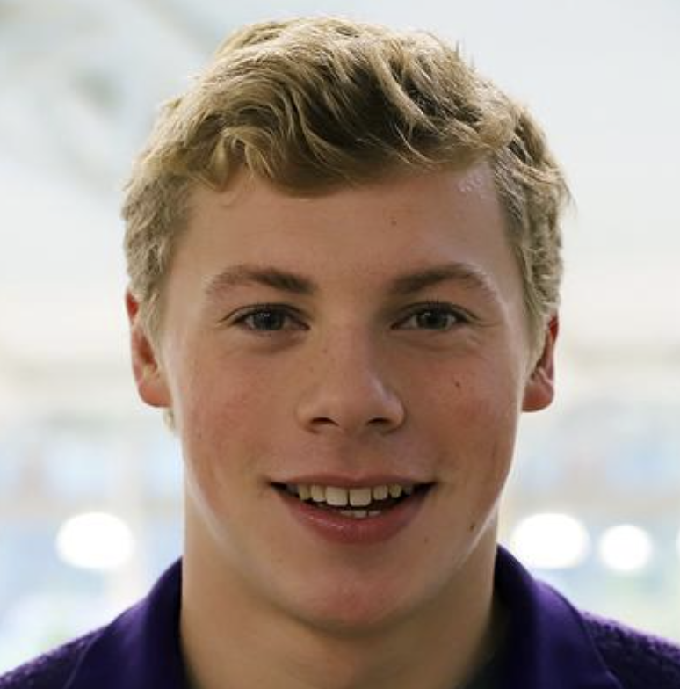

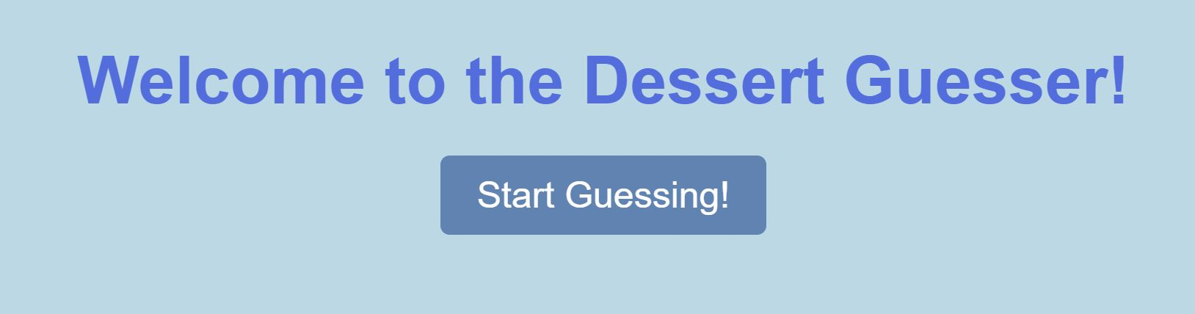
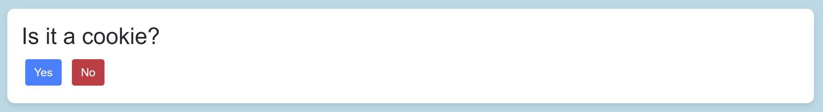
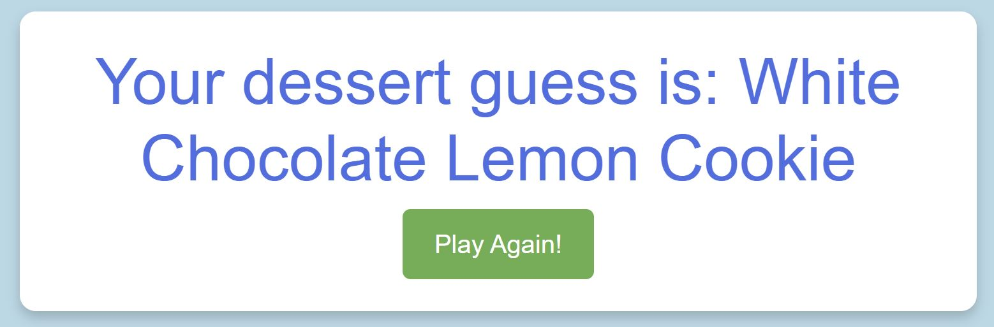



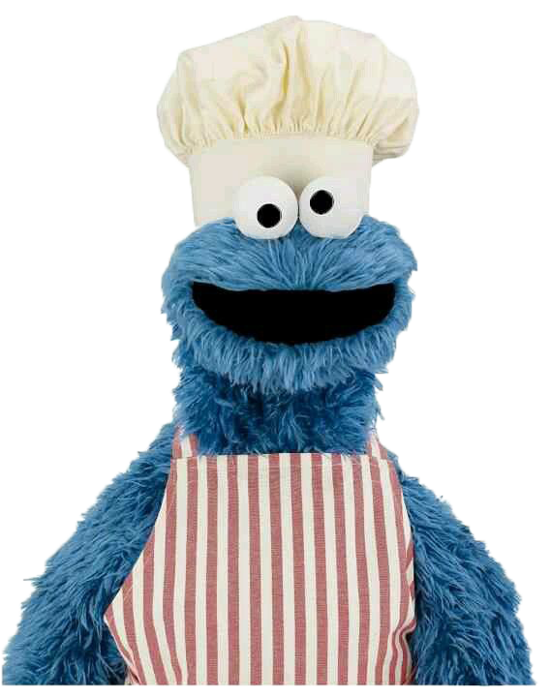
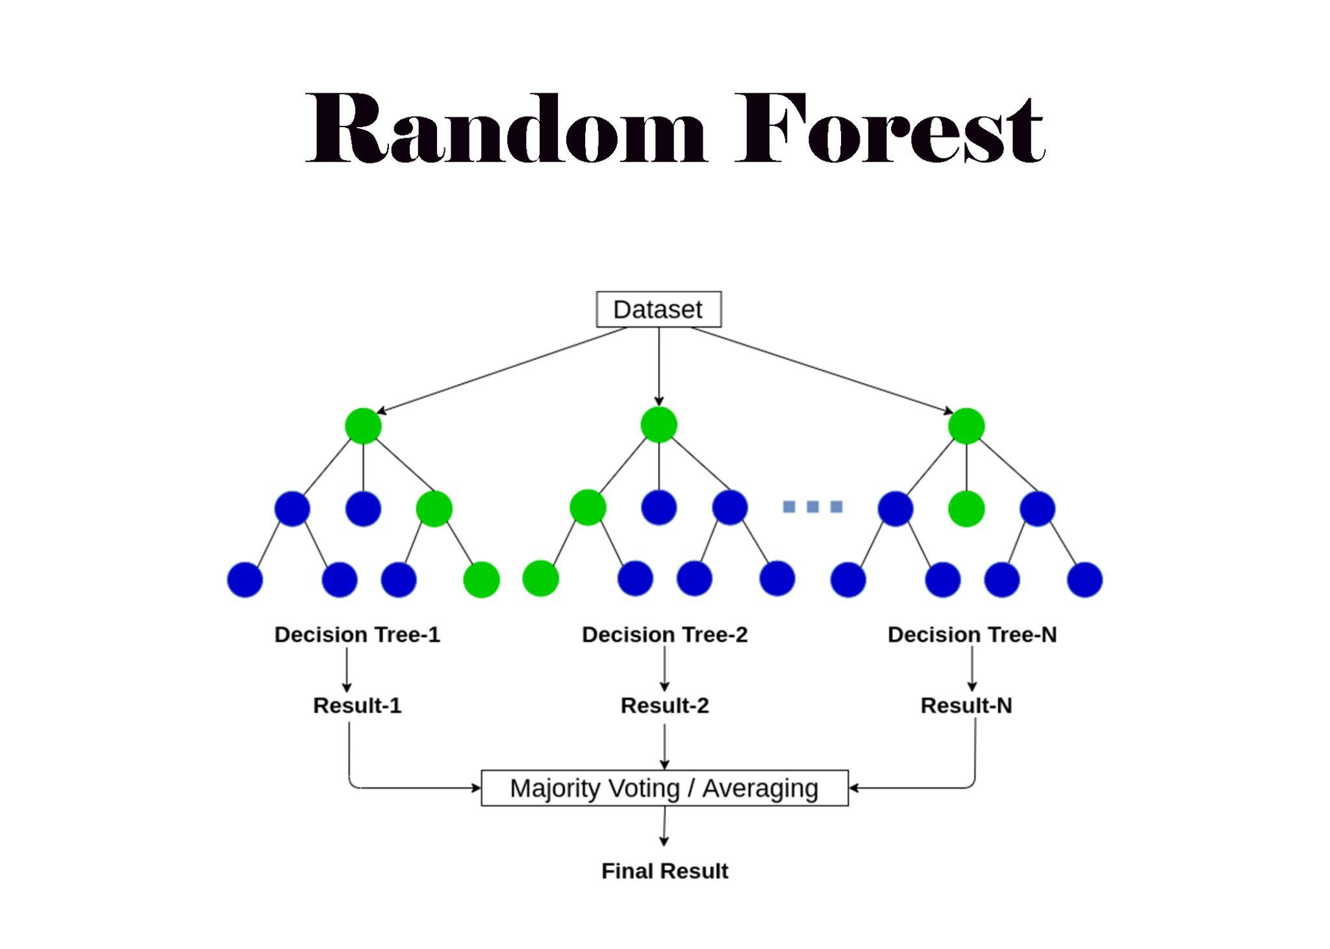
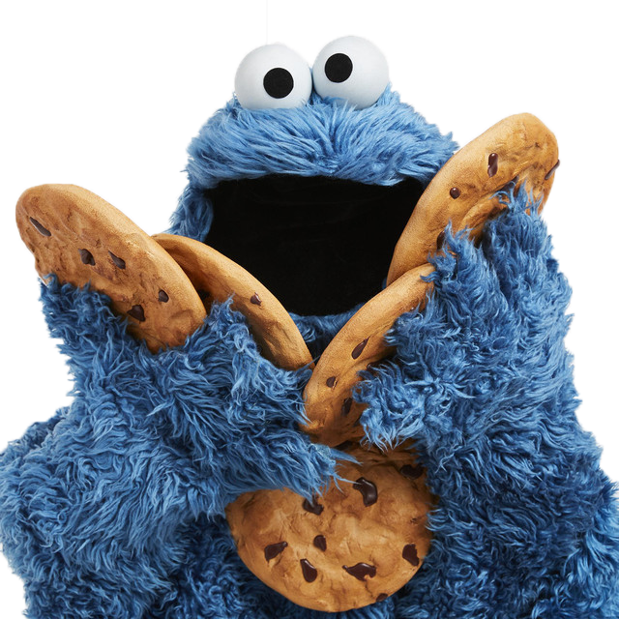

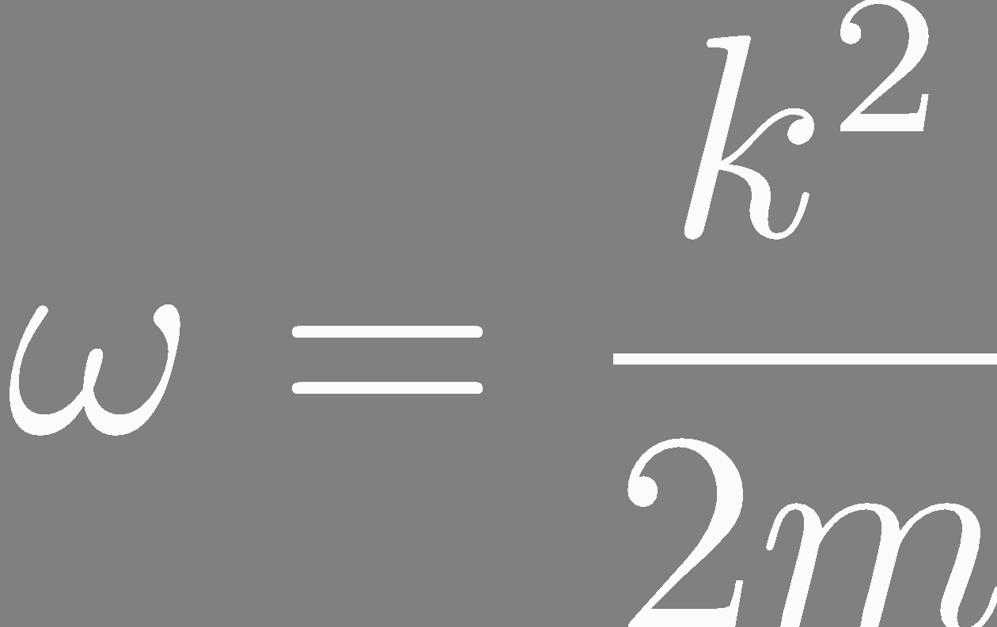

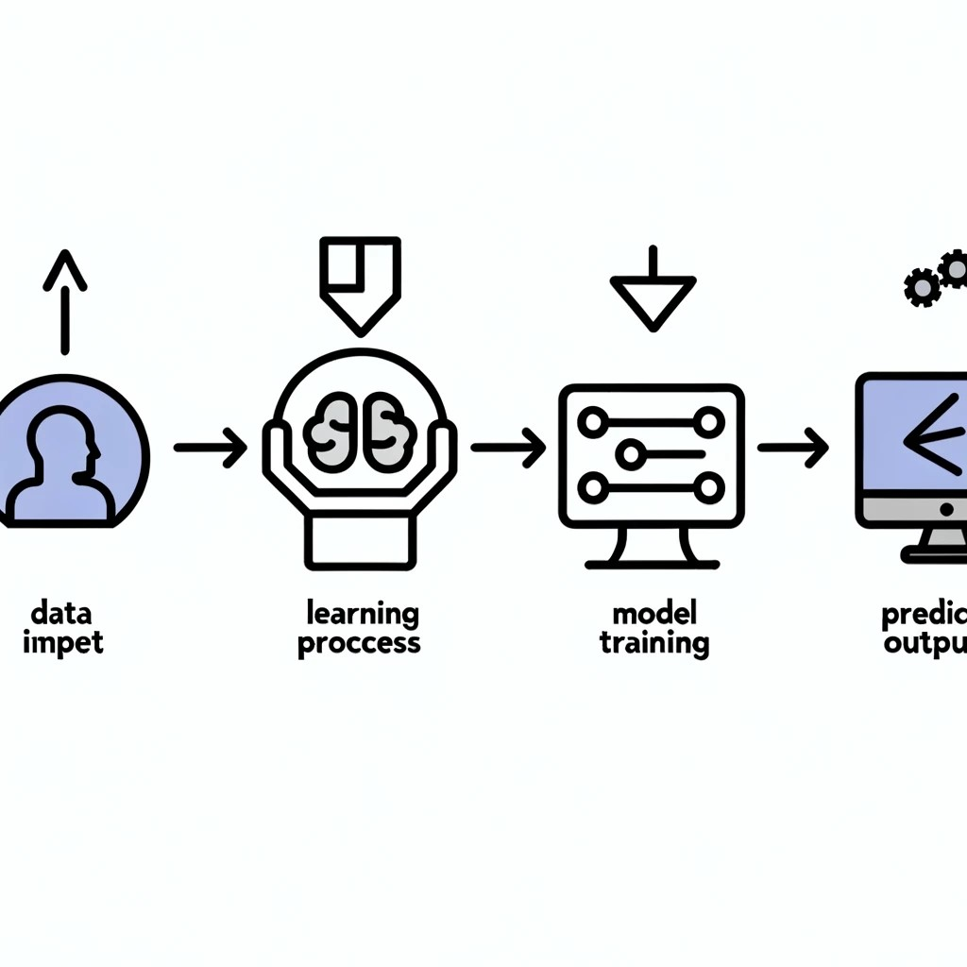

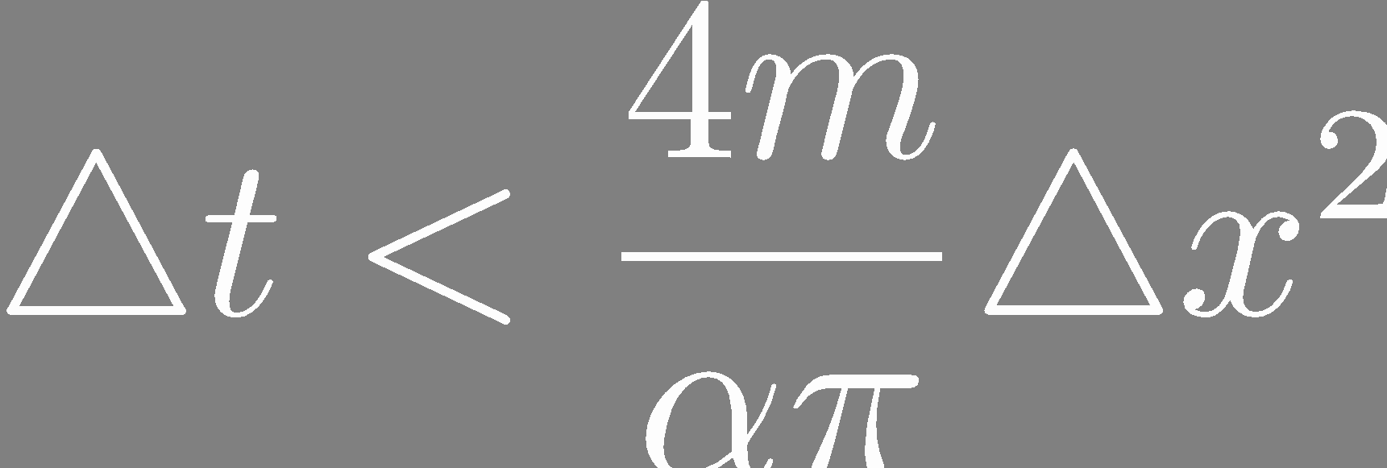
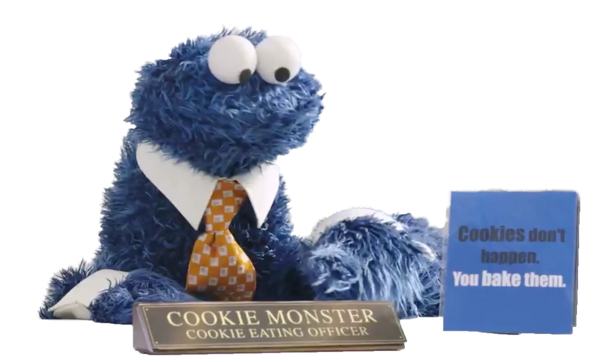
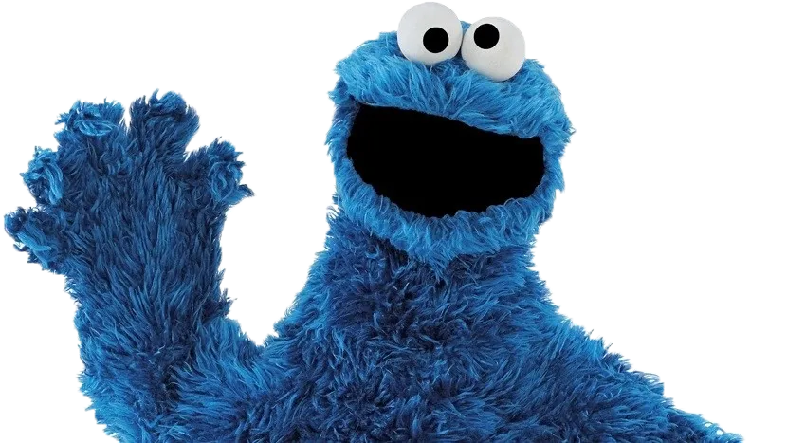

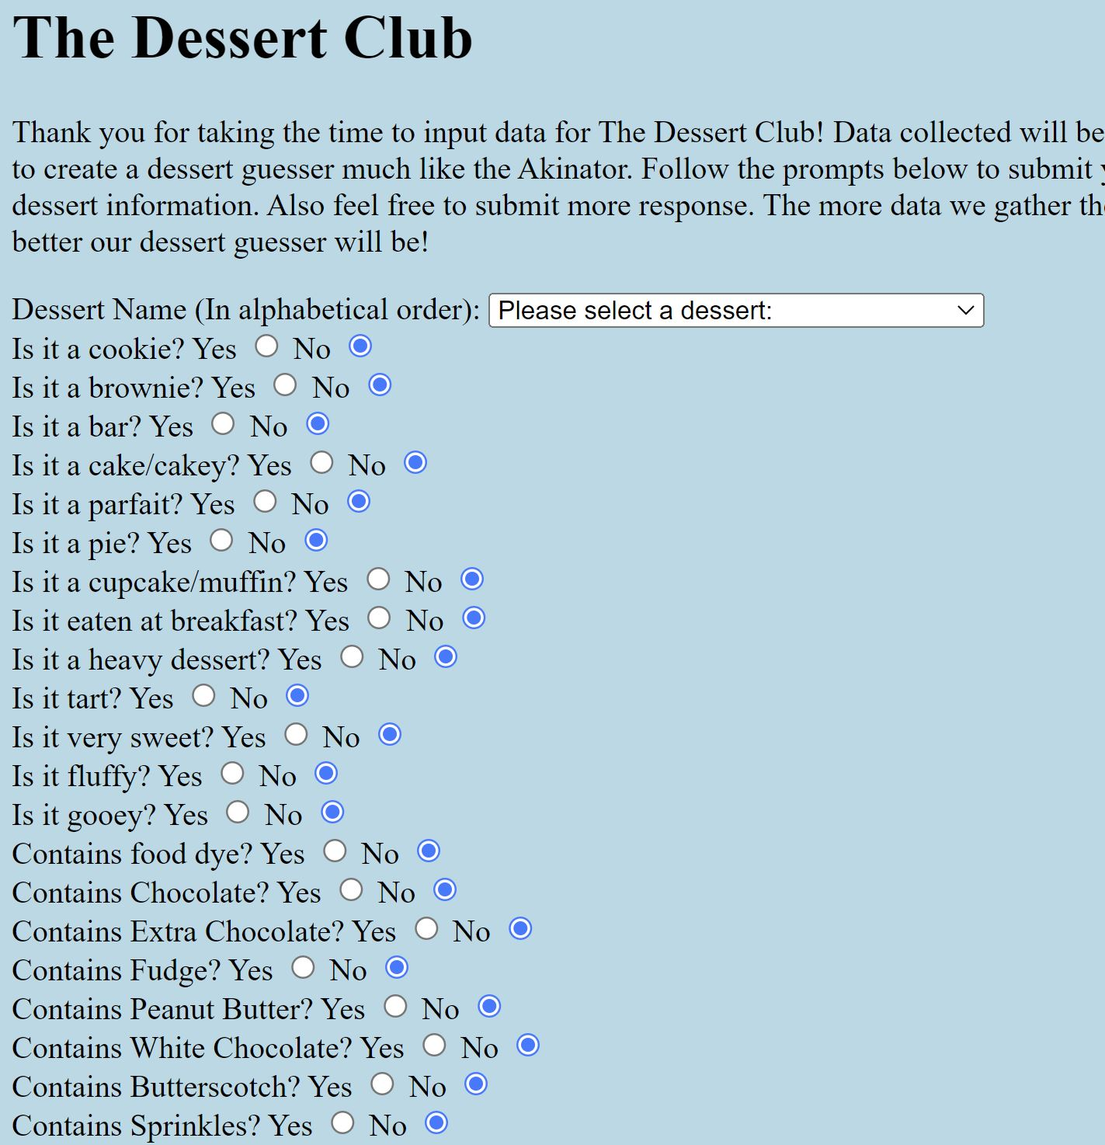
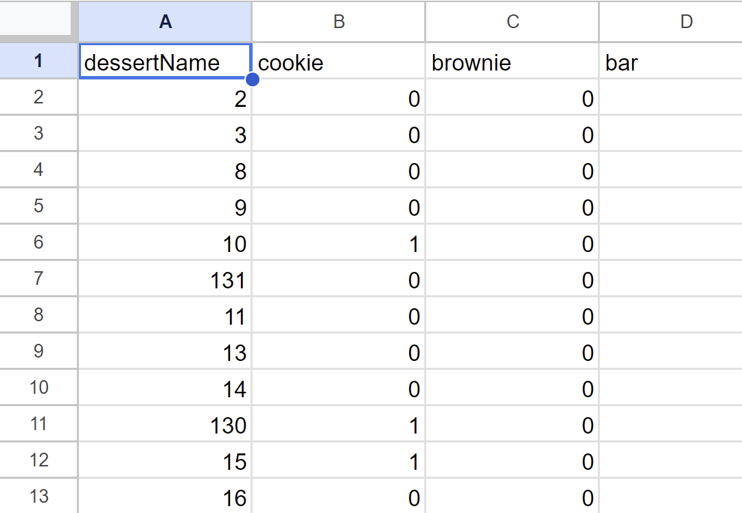
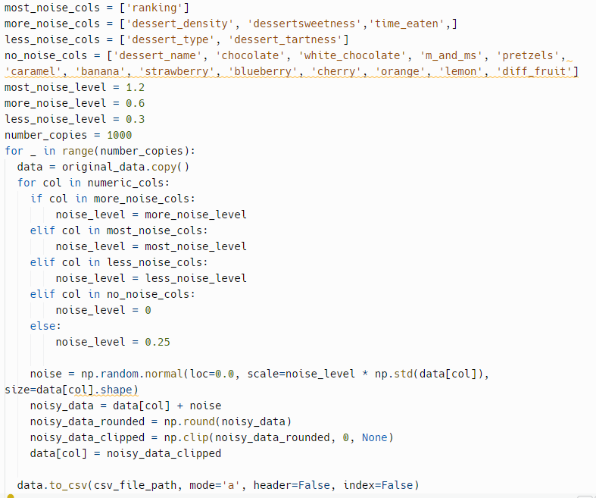
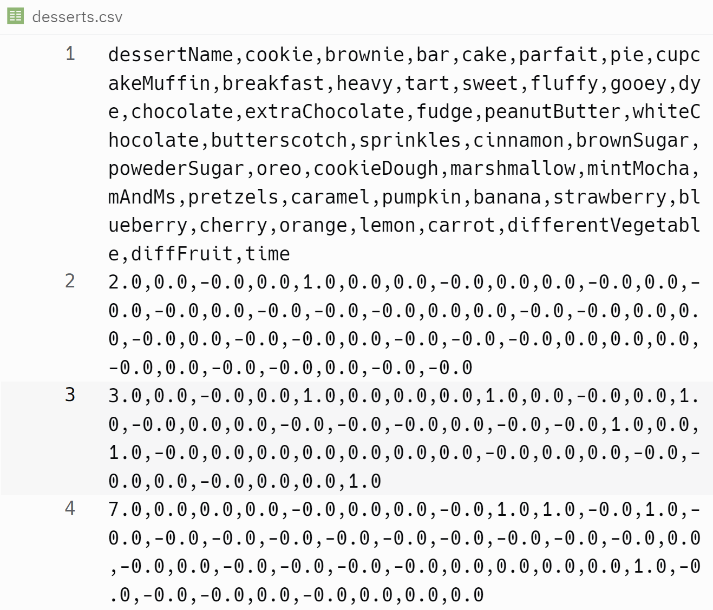
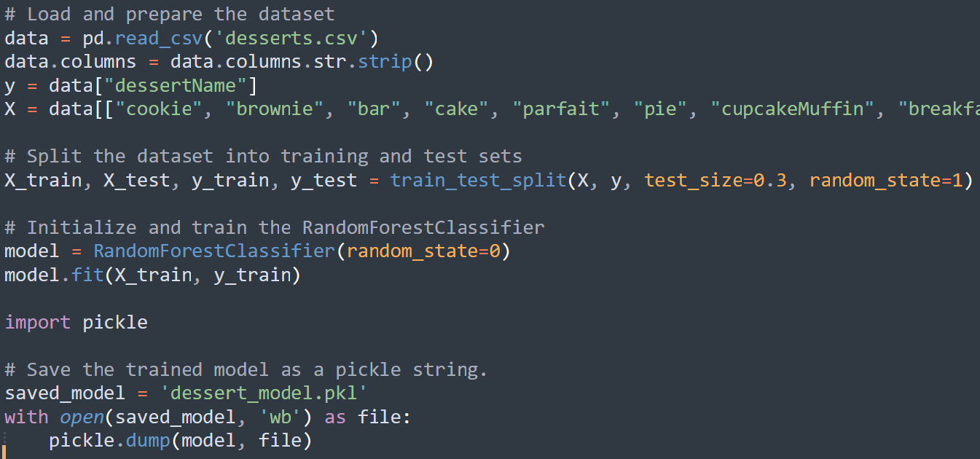
The Dessert Club (Machine Learning) Noah Hargrove, Noah Aydin COMP 401 Seminar, Kenyon College
Project Overview
Dessert Guesser
Conclusions
Create a Dessert Guesser that:
Brings people together
Practice in machine learning
Provides information for AVI staff
Tool for instructors of younger ages
Survey to gather UI data from students
Create machine learning (ML) program - selected model, use UI data to train
Create Dessert Guesser from ML alg. on Web application using Flask
Machine Learning (ML) is a complex but powerful tool for correct classification. The Dessert Club Dessert Guesser implements a Random Forest (RF) alg. to correctly classify (identify) Peirce desserts based on characteristics.
System Architecture
UI of Dessert Guesser: Short demo of interface of complete dessert guesser using Flask.
System Architecture - Overview
Initial Web application to collect data (~200 obs)
Increase sample size (~10,000 obs) with noise for training ML
Select ML alg. → Random Forest
Implement ML alg into guesser
Implement guesser into Flask
Random Forest Alg.
Repl.it increase / creating synthetic data with noise*
Web app
Survey
Interactive dessert guesser on Flask*
Repl.it Implementation / Selection of Machine Learning*
UI data
Machine Learning Program*
Tree Construction: Builds multiple trees using random samples of data and features at each decision point, leads to prediction accuracy and stability.
Versatile and Robust: RF works for both regression and classification, handles different types of data, reduces overfitting by averaging results from multiple decision trees.
RF Importance: Easily identifies which features are most influential in predicting outcomes, focuses on the most impactful data.
Motivation
Data Flow
Trivial topic to bring people together
Helps instructors of children like teachers/coaches
Data for AVI staff to improve desserts
Practice in ML implementation
Web application - App script to Google Sheets (~200 obs)
Data Manipulation - Google Sheet to repl.it to csv, increase sample by adding noise to data ( ~10,000 obs)
ML - Use data with noise to train RF
UI (Flask) - UI with website to flask code back to website output
References / Acknowledgements
Professor Skon - Instructor, consultant
Classmates - Feedback and constructive criticism: Vaughn Hajra, Casey Watkins - specific feedback and direction with ML.
Target Audience - Kenyon Students, AVI staff, Instructors of youth.
Thanks to Maggie Murphree and Cecina Babich Morrow for loaning me graphics for this template.
UI Data Flow: Flow of data from User to a trained RF algorithm that can be implemented into Dessert Guesser. Start with Web App → Google Sheet → Repl.it adding Noise (increase # obs) → CSV → Trained RF alg.
Notes:
is there a rubric i can look at for this? because it seems like obviously since it’s a poster you highlight a limited number of things you touch on in the presentation so i just wanted to see if that impacted what u chose
i do really enjoy how you have a good mix of images/diagrams because it breaks it up very well
this is more of an aesthetic thing but if you are interested in adding borders under each heading (basically just making the border color visible and darker) i can show you what i did for my poster which i ended up really liking (i can call u about it if you’d like)

